Slide 1



De novo assembly of bacterial genomes with INNUCA pipeline
ONEIDA WS
2-4 May 2018
Instituto Gulbenkian Ciência, Oeiras Portugal
João André Carriço and Miguel Machado
24/10/2017

Slide 2
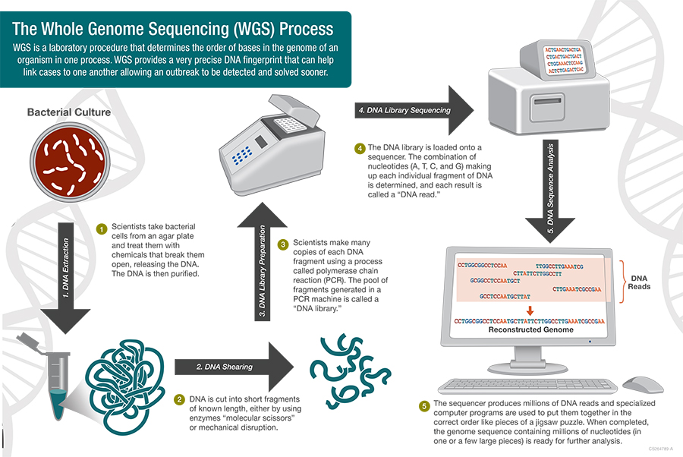
Whole Genome Sequencing: Need for QA/QC
Barcode bleaching
C
C
Contamination
E. fergusonii
Wrong file assignment
E. coli
Mislabelling
Mixture
https://www.cdc.gov/pulsenet/pathogens/wgs.html

Slide 3
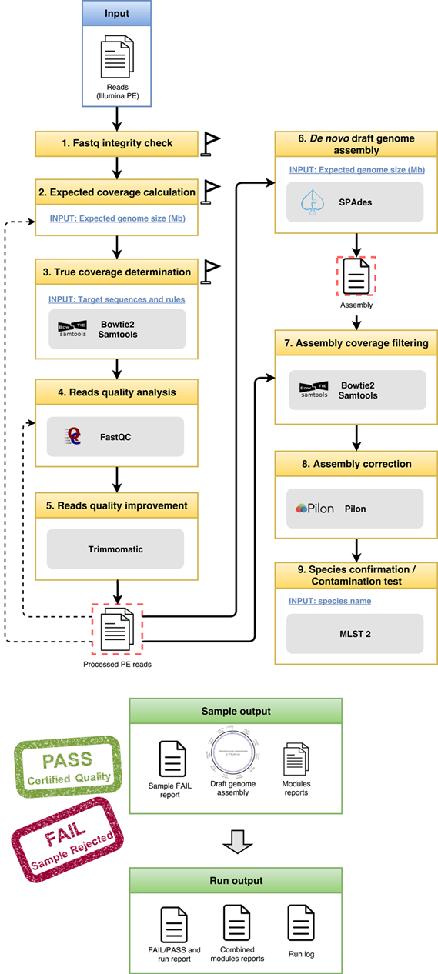





INNUca - INNUENDO QA/QC for reads and assembly
Dependencies
http://cab.spbu.ru/software/spades/
https://github.com/broadinstitute/pilon
MLST 2
https://github.com/tseemann/mlst
http://bowtie-bio.sourceforge.net/bowtie2/index.shtml
samtools
http://www.htslib.org/
http://www.bioinformatics.babraham.ac.uk/projects/fastqc/
$ git clone https://github.com/B-UMMI/INNUca
$ INNUca.py
-i reads_dir/
-s “Escherichia coli”
-g 5
==========> INNUca.py <==========
Program start: Wed Feb 12 13:32:37 2017
LOGFILE:
/home/<user>/innuca/run.20170712-133237.log
COMMAND:
python /home/<user>/NGStools/INNUca/INNUca.py

Slide 4

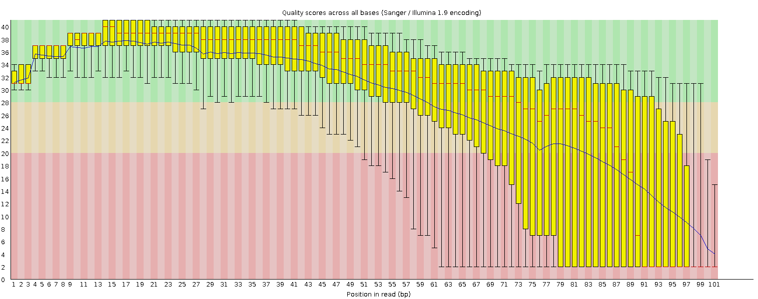
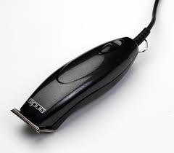
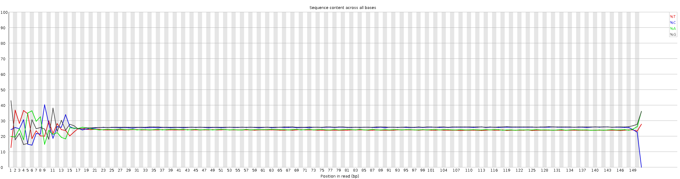
Read quality
Problems
Bad quality reads
Adapters contamination
Incorrect genome assembly or SNP calls
Solutions
“Clean” the reads by trimming /clipping
FastQC
http://www.bioinformatics.babraham.ac.uk/projects/fastqc/
Per base sequence quality
Adaptor and Quality trimming:
trimmomatic
http://www.usadellab.org/cms/?page=trimmomatic
Per base sequence content

Slide 5
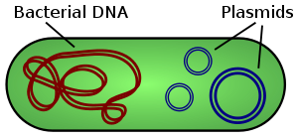
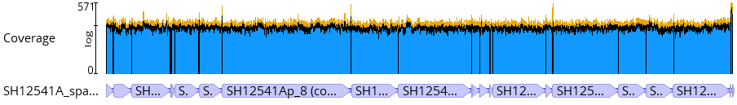
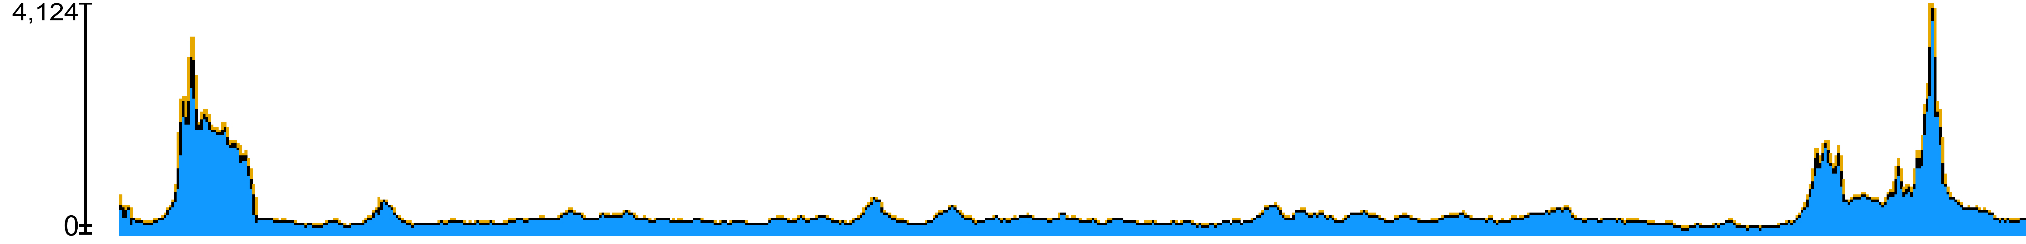
Genome coverage depth
INNUCA assesses Coverage at multiple checkpoints
Problems
Low sequence coverage
Miss some genomic regions
Incorrect genome assembly or SNP calls
Solutions
Simple math:
sequenced nucleotides / genome size
Map reads against target regions
Avoids account overrepresented sequences
Map reads against assembly

Slide 6
Genome coverage depth
1st Assembly
Coverage
2nd Assembly
Coverage
Spades
Filtered Contigs
Bowtie2
Corrected Contigs
Raw
Reads
Clean
Reads
Second coverage *
Trimmomatic
ReMatCh
True coverage *
First coverage *
* Pipeline is stopped if a defined threshold coverage is not met (defaults: First and Second coverage: 15x ; True coverage : 25x)

Slide 7
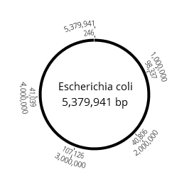
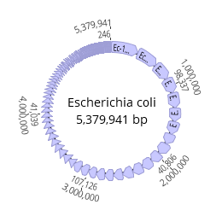
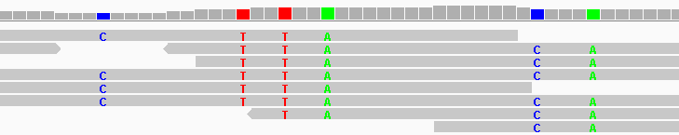
Assembled genome
Problems
High fragmentation (High # of contigs)
Lost regions (repeat regions)
Contamination
Misassemblies
Incorrect allele call
Solutions
Control for genome fragmentation (# contigs)
Correct the assembly (Pilon)
T
C
C
G
A
T

Slide 8

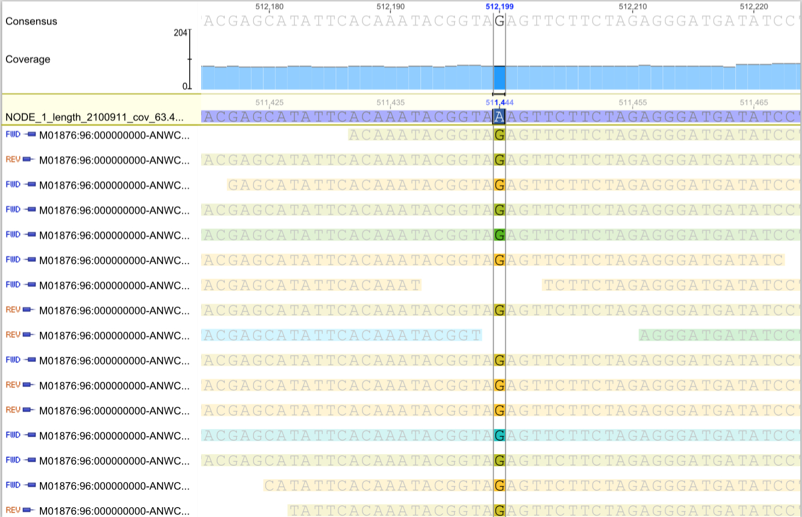
De novo Assembly
SPADes
V 3.11
De novo assembler can introduce errors in the assembly
http://bioinf.spbau.ru/spades
PILON
79 reads (expected errors: 0.02; at least Q30 98.7%): 72 G and 7 A
http://software.broadinstitute.org/software/pilon/

Slide 9
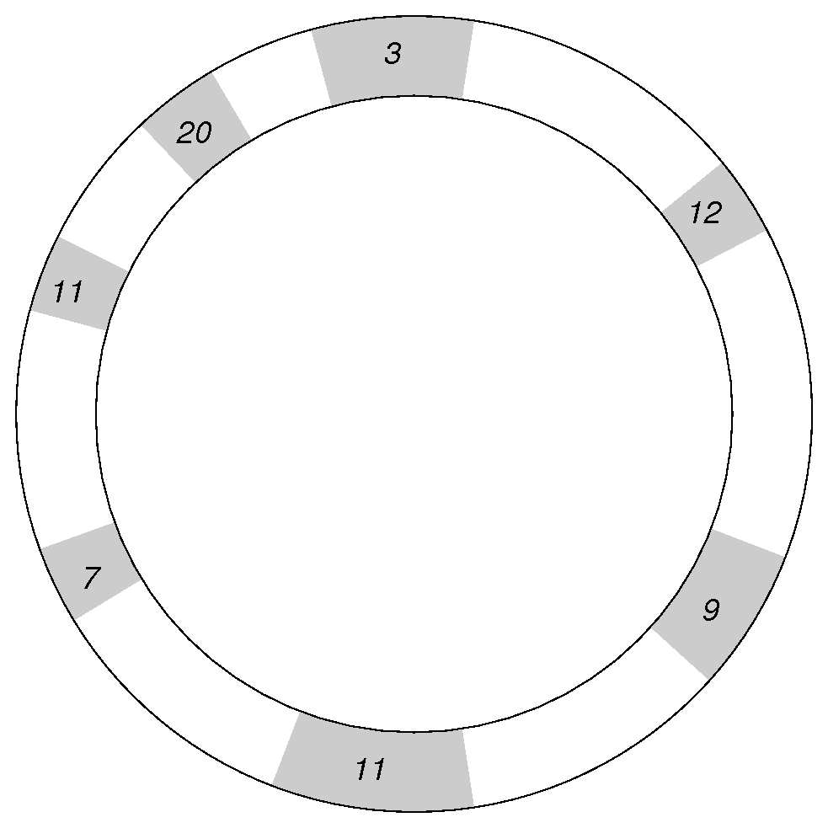
mlst2 : quick and dirty contamination check
MLST2: in silico Multi Locus Sequence Typing from draft genomes (contigs). Very Fast implementation.
https://github.com/tseemann/mlst
Script uses all schemas in Pubmlst.org:
Total of 118 bacterial species species
All MLST Schemas
Bacterial
chromosome
Contigs
BLAST
Best 7 hits
7 housekeeping genes define a MLST schema
Allelic profile:
12 - 9 - 11 - 7 - 11 - 20 - 3
Each allelic profile, aka Sequence Type (ST),
is unequivocally identified by an integer.
Infer the species and schema
Infer the allelic profile and ST
Contaminated assemblies usually miss one or more genes
or the schema can’t be assigned

Slide 10
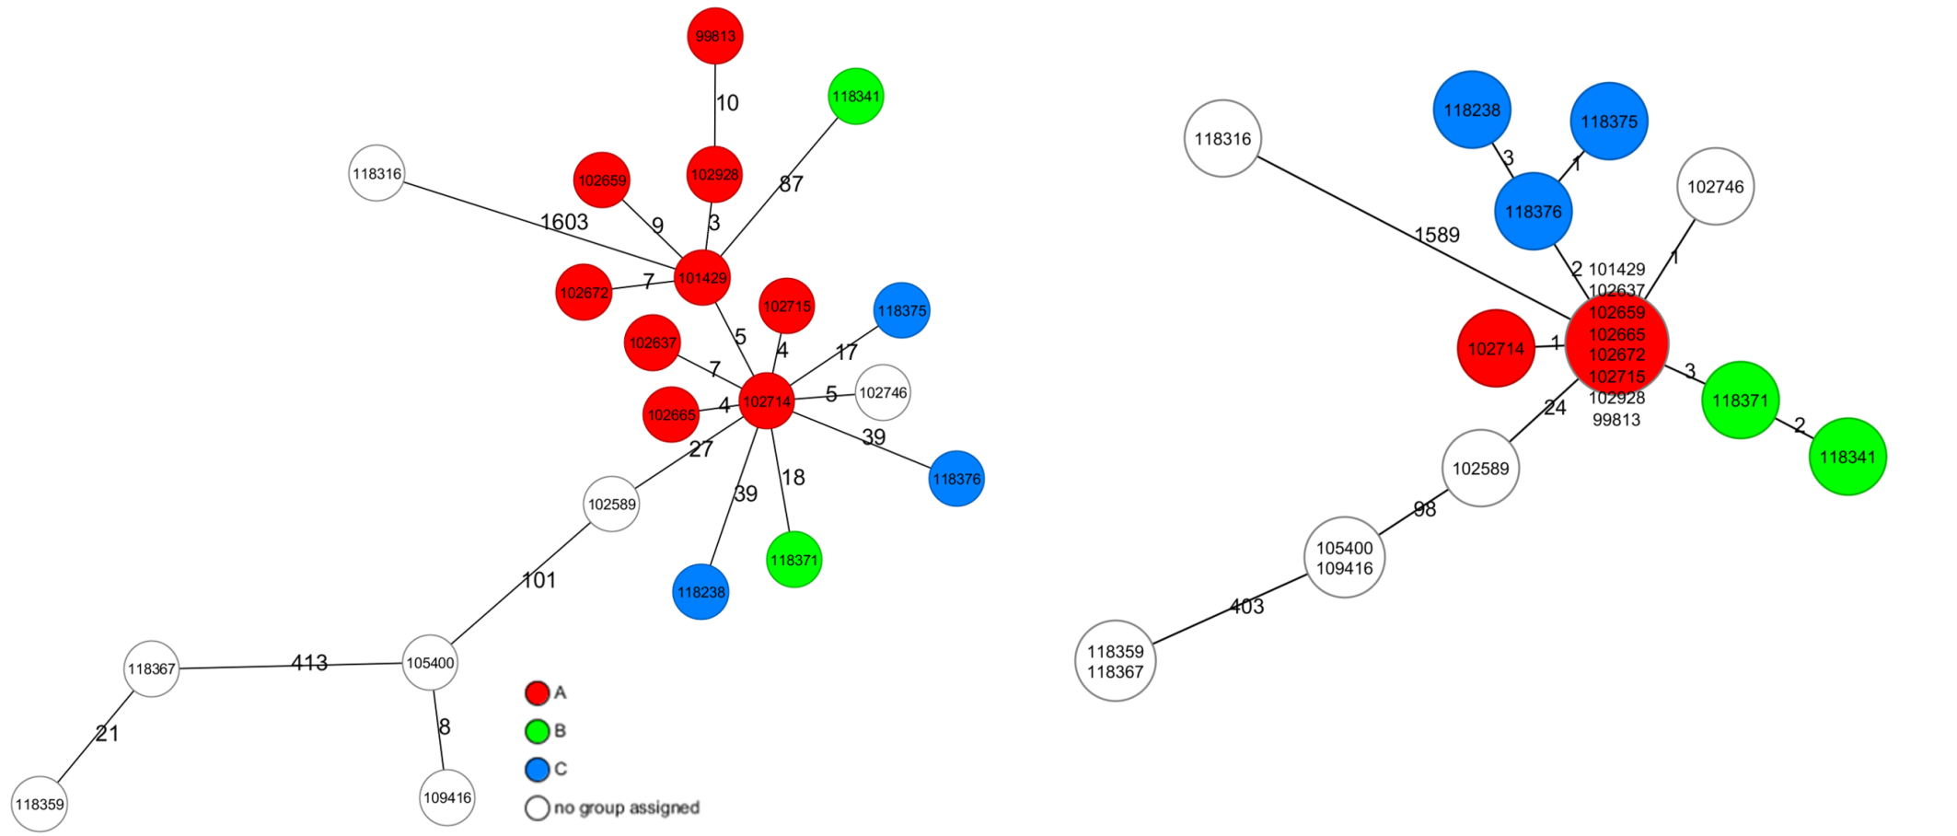
QA/QC: Whole Genome Sequencing context
“Raw” SPAdes assembly
INNUCA assembly
Well clustered groups
QA/QC is critical for high quality results
Incorrectly processed data or circumventing of quality assessment can lead to incorrect results

Slide 11
INNUca Benchmark
5 runs of the same sample
Intel® XeonTM E5-2630 v4 @ 2.20GHz CPUs, 128Gb RAM and an SSD distributed storage in RAID1
Final assembly size: 2017926 bp
First estimated coverage: 115.2x
Second estimated coverage: 87.2x
Assembly coverage: 90.35x

Slide 12
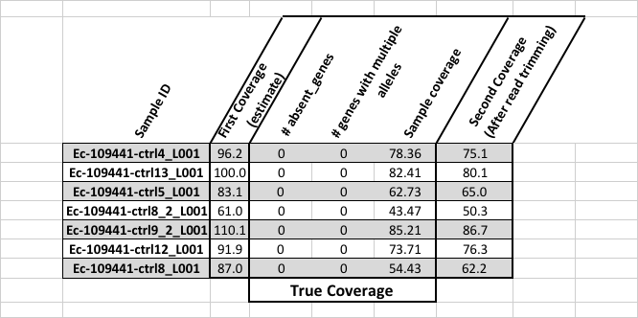
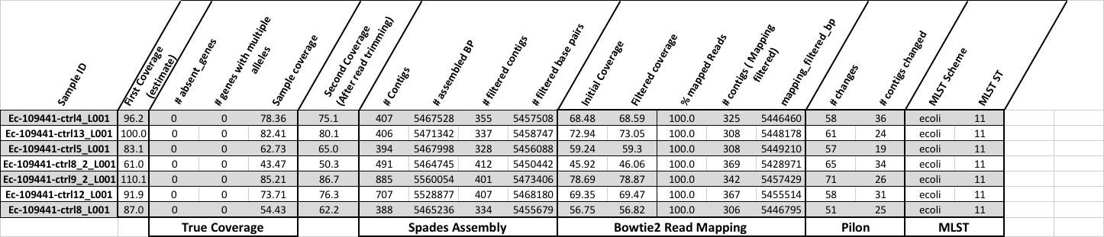
INNUca output
Output
Contamination and
multi-strain detection
Benchmark
Contig filtering:
GC content
K-mer coverage
Length ( min = max(read length))
20-40 mins per strain (60x-100x coverage; 8 CPUs)
High Performance Cluster:
6-7 nodes, 244 CPUs used : 3h57m for 124 E.coli ~=1.9 mins per strain

Slide 13
INNUca nextflow
“Data-driven computational pipelines”
“Nextflow enables scalable and reproducible scientific workflows using software containers. It allows the adaptation of pipelines written in the most common scripting languages.”
https://www.nextflow.io/
Advantages
Uses docker containers publicly shared (https://hub.docker.com/r/ummidock/)
Fine-tuning of parameters per software module
Optimized for SLURM HPC
Since pipeline is in github you can run it anywhere with nextflow and docker
https://github.com/ODiogoSilva/innuca-nf
# Simple run – searches a “data” folder nextflow run odiogosilva/innuca-nf
# Specifying fastq nextflow run odiogosilva/innuca-nf --fastq-files="somedir/*_{1,2}.*.gz
# For Slurm nextflow run odiogsilva/innuca-nf -profile slurm

Slide 14
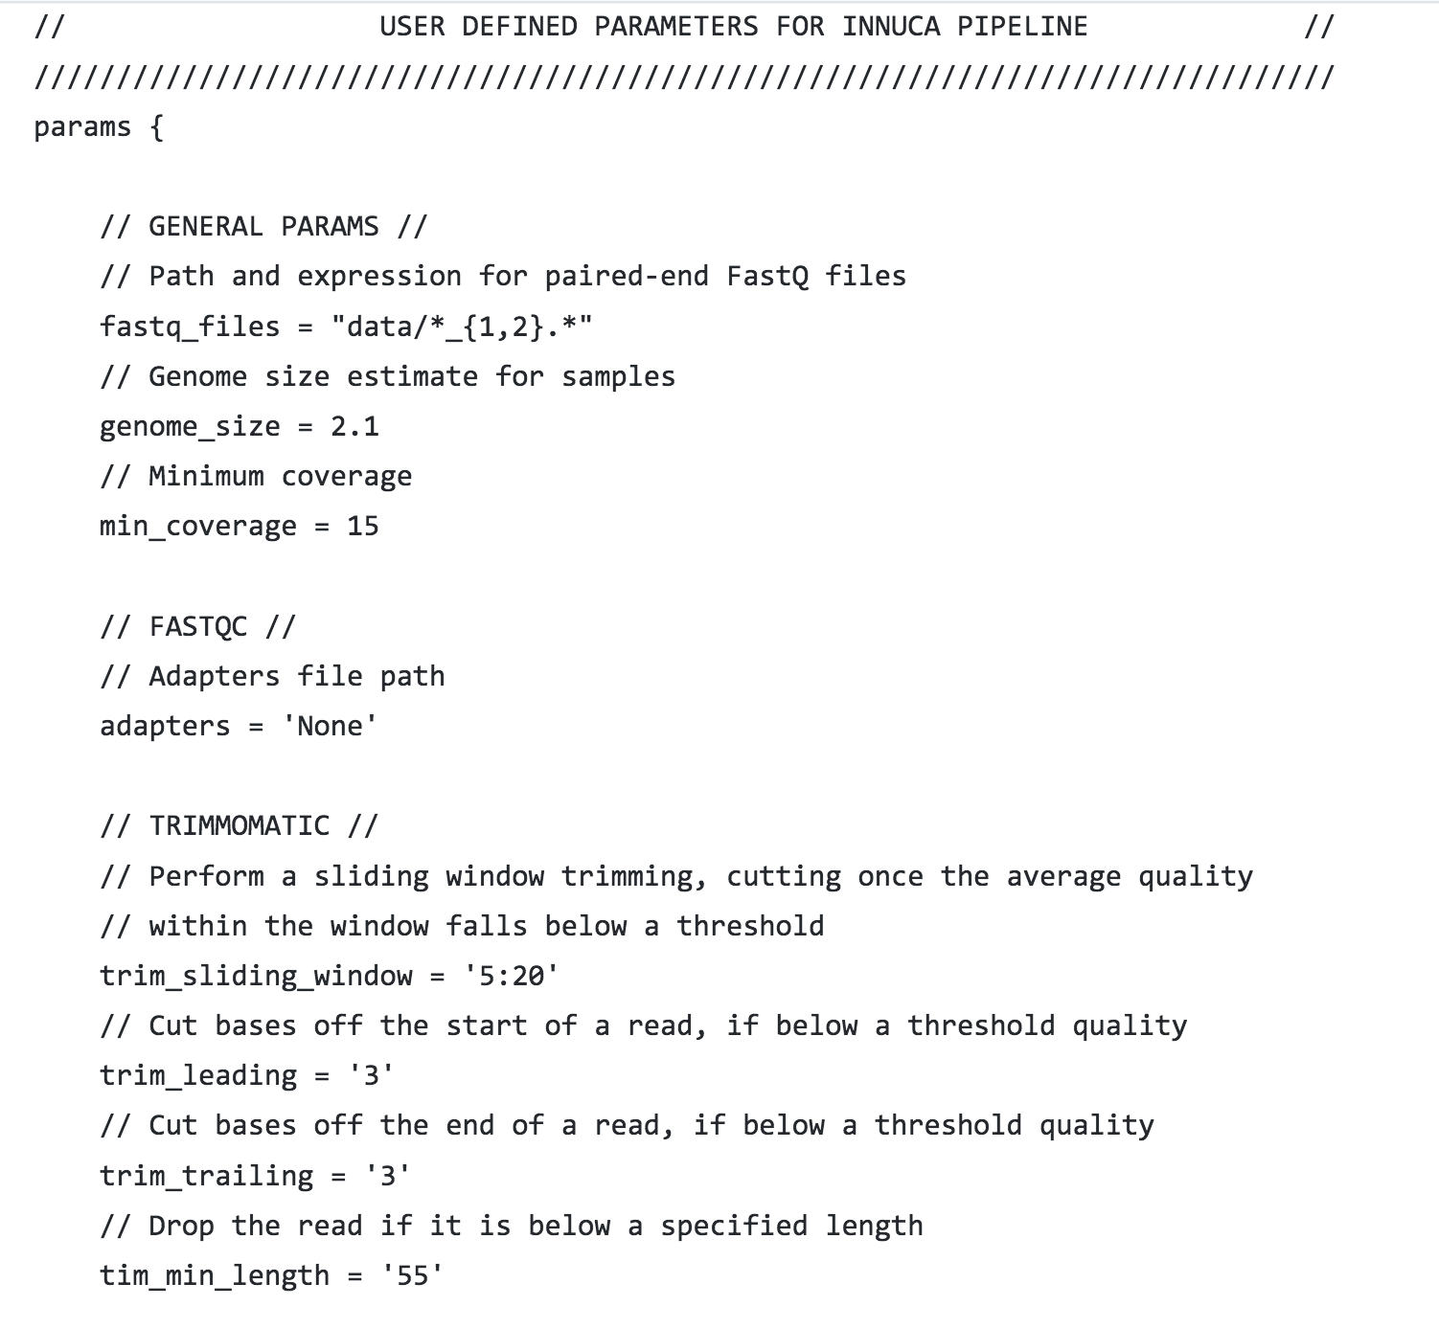
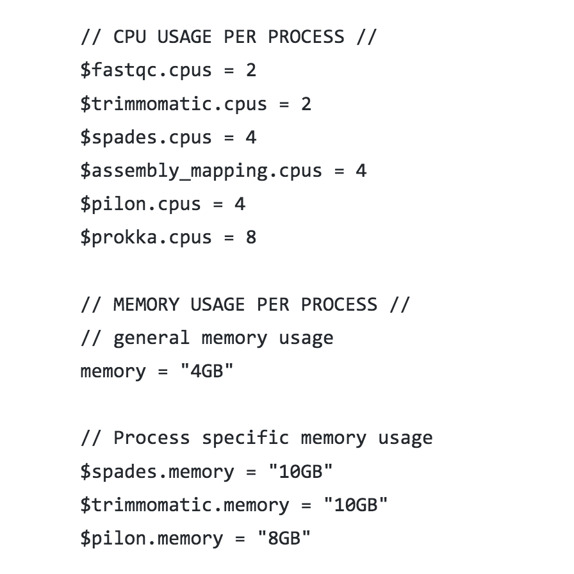
INNUca nextflow :
configuration
Default parameters
Fine-tuning of parameters per software module
Definition of profiles
https://github.com/ODiogoSilva/innuca-nf/blob/master/nextflow.config

Slide 15
INNUca nextflow
Directed Acyclic Graph (DAG)
representing the data and process flow

Slide 16
INNUca nextflow – detailed run report
HPC cluster:
Intel® XeonTM E5-2630 v4 @ 2.20GHz CPUs, 128Gb RAM and an SSD distributed storage
FastQC
Trimmomatic
FastQC
Spades
Bowtie2
Pilon
mlst

Slide 17
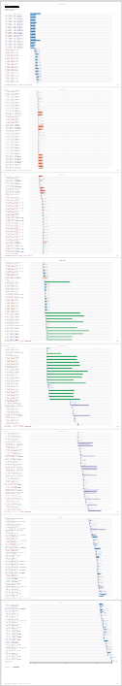
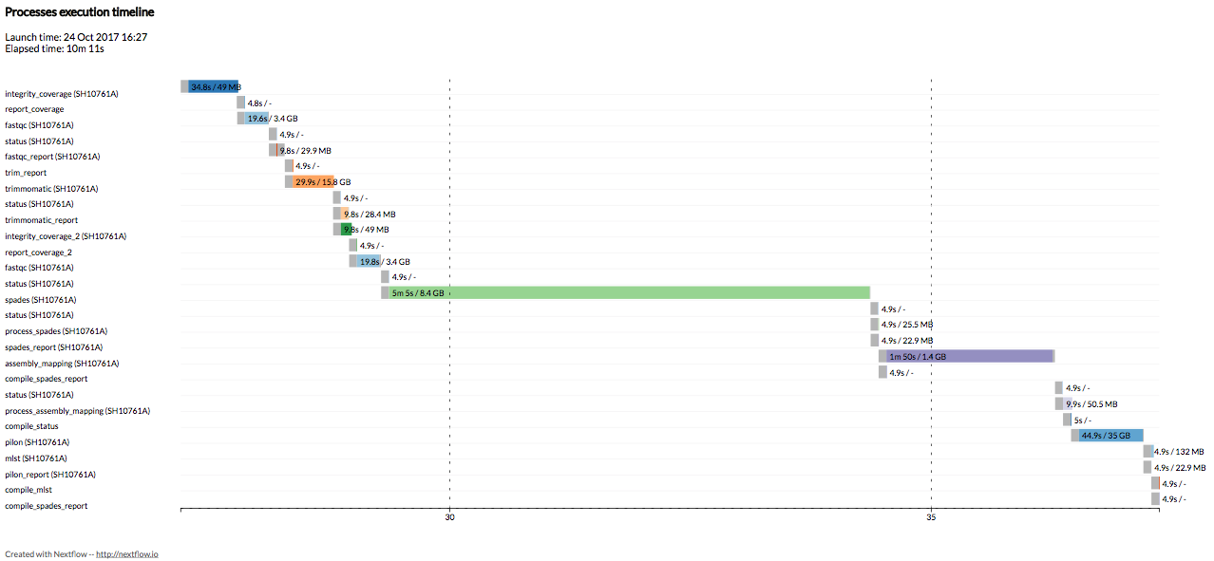
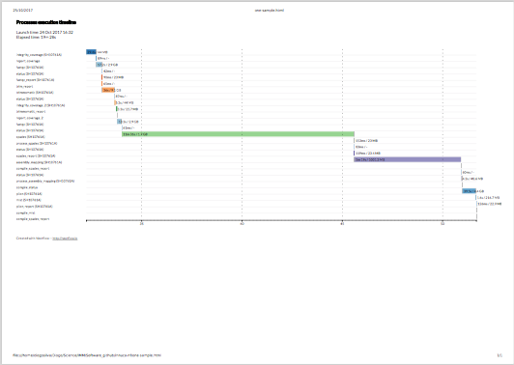
INNUca nextflow - benchmark
HPC cluster:
Intel® XeonTM E5-2630 v4 @ 2.20GHz CPUs, 128Gb RAM and an SSD distributed storage
~10 mins
(max 4 CPUs)
24 strains in 13 mins
~ 32.5 secs /strain
(max 120 CPU used /
4 CPU max per process)
Laptop: Intel® CoreTM i5-7200U @ 2.50GHz x 4 CPUs,
8Gb RAM,NVMe SSD storage
~19 mins

Slide 18
Conclusions and Future Work
INNUCA offers an efficient bacterial de novo assembly pipeline with integrated QA/QC steps
Integration with a workflow manager (nextflow.io) greatly increases the flexibility, standardization, troubleshooting and reporting
Use of HPCs allow for excellent average analysis times
INNUCA is open-source and available in https://github.com/B-UMMI/INNUca ; INNUCA-nextflow is also open-source and available in https://github.com/ODiogoSilva/innuca-nf
Future work will use k-mer methods on reads for automatic species identification and subsequence genome size estimation

Slide 19







Acknowledgments
INNUENDO project
[European Food Safety Authority, GP/EFSA/AFSCO/2015/01/CT2]
Miguel Machado (UL) Mirko Rossi (UH)
Mário Ramírez (UL)
Mickael Silva (UL)
Bruno Gonçalves (UL)
Diogo N Silva (UL)
Inês Mendes (UL)
Vítor Borges (INSA)
Jani Halkilahti (THL)
BACGENTRACK project [FCT / Scientific and Technological Research Council of Turkey (Türkiye Bilimsel ve Teknolojik Araştırma Kurumu, TÜBİTAK), TUBITAK/0004/2014]
Disclaimer
The conclusions, findings, and opinions expressed in this presentation reflect only the view of the INNUENDO consortium members and not the official position of the European Food Safety Authority nor of the Government of the Basque Country that are not responsible for any use that may be made of the information they contain.

